Slide 1
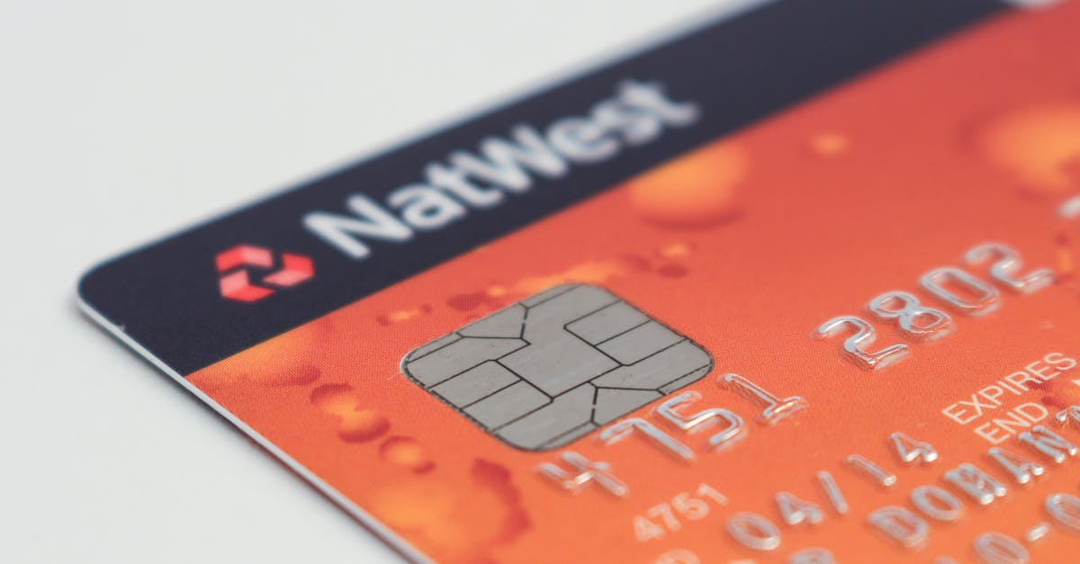
Credit Card Fraud Detection
 | By: Nishigandha Patkar

Slide 2
Aim -:
Enhancing credit card fraud detection is a priority for all banks and financial organizations. Thanks to machine learning (ML), credit card fraud detection is becoming easier and more efficient. ML-based fraud detection solutions can track patterns and prevent abnormal transactions.
The benefits of using machine learning for credit card fraud detection
Machine learning (ML) models are much better than conventional fraud detection models. They can recognize thousands of patterns from large datasets.
ML offers an insight into how users behave by understanding their app usage, payments, and transaction methods. Some of the benefits of fraud detection using ML are as follows:
Faster detection
A machine learning model can quickly identify any drifts from regular transactions and user behavior's in real time.
By recognizing anomalies, such as a sudden increase in transactional amount or location change, ML algorithms can minimize the risk of fraud and ensure more secure transactions.
Higher accuracy
Conventional fraud detection techniques cause errors at the payment gateways that sometimes result in genuine customers being blocked.
With sufficient training data and insights, ML models can achieve higher accuracy and precision, reducing these errors along with the time required to be spent on performing manual analysis.
Improved efficiency with larger data
Once an algorithm picks up different transactional patterns and behavior's, it can efficiently work with large datasets to separate authentic payments from fraudulent ones.
The models can analyze huge amounts of data in seconds while offering real-time insights for improved decision-making capabilities.

Slide 3
Data-Set Link -: https://www.kaggle.com/mlg-ulb/creditcardfraud
ML Algorithm Used For this Project -:
LOGISTIC REGRESSION
XGBOOST
DECISION TREE
RANDOM FOREST

Slide 4
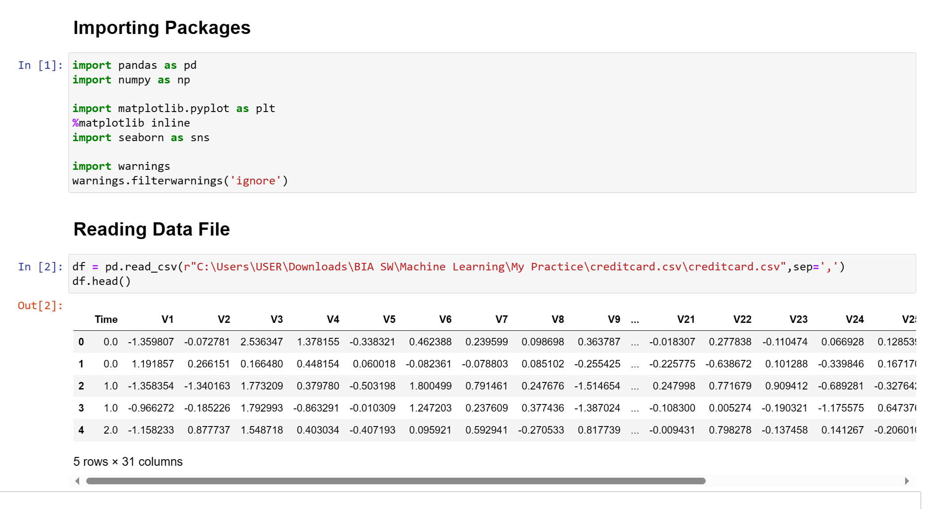
Reading data using pandas after importing some necessary packages. To dive into a further Analyzation.

Slide 5
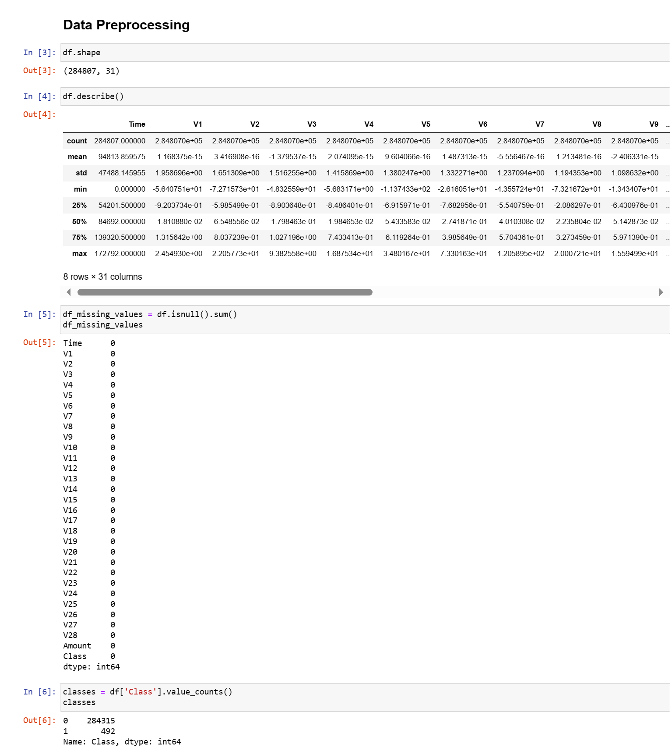
After reading the data, we will do most important step which is Data Preprocessing.
Dealing with data processing helps us to built a efficient model.

Slide 6
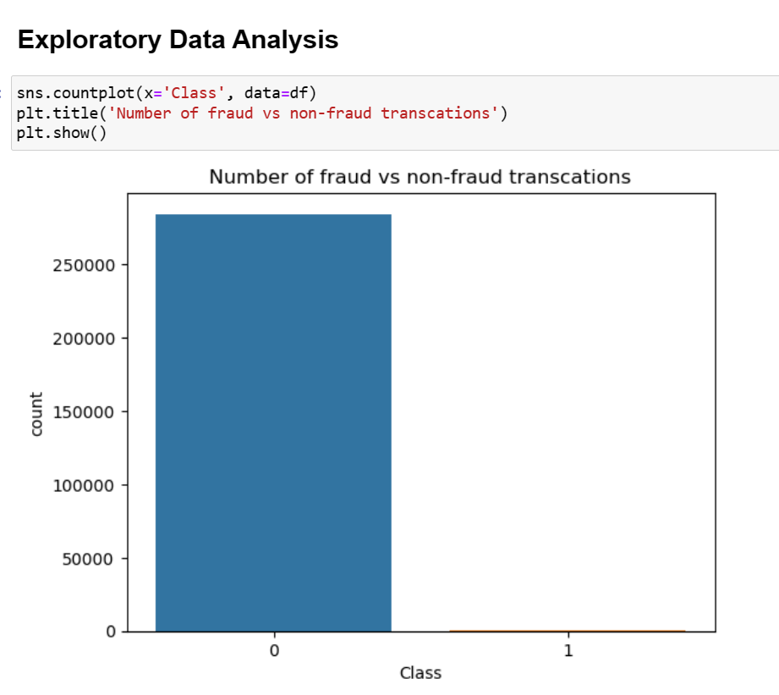
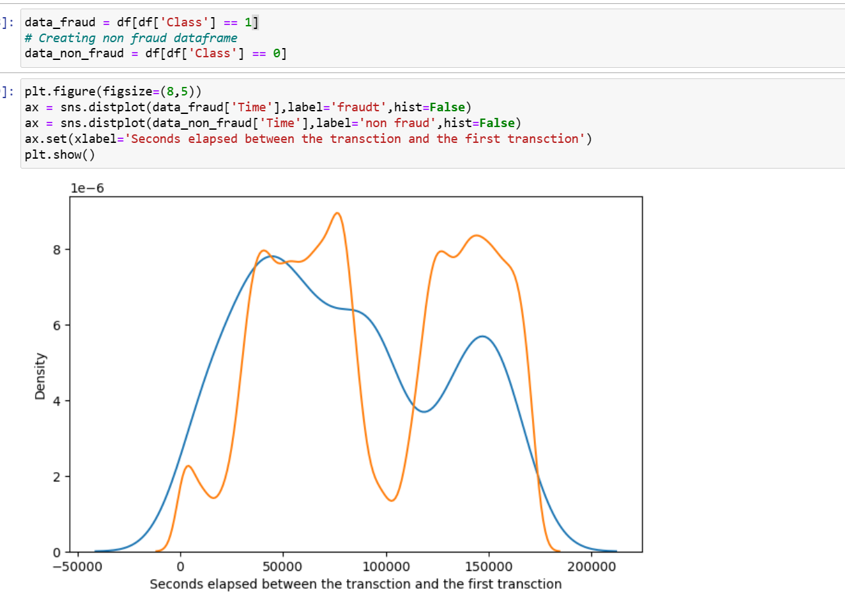
Once the data pre-Processing is done. We can be move forward with Exploratory data Analysis.
Here we are doing visualization to know the wide spread of Fraudulent and Non-Fraudulent Transaction.
We are calculating the relationship of Fraudulent and Non- Fraudulent transaction with respect to Time.
We do not see any specific pattern for the Fraudulent and Non- Fraudulent data with respect to Time. Hence, we can drop the column.

Slide 7
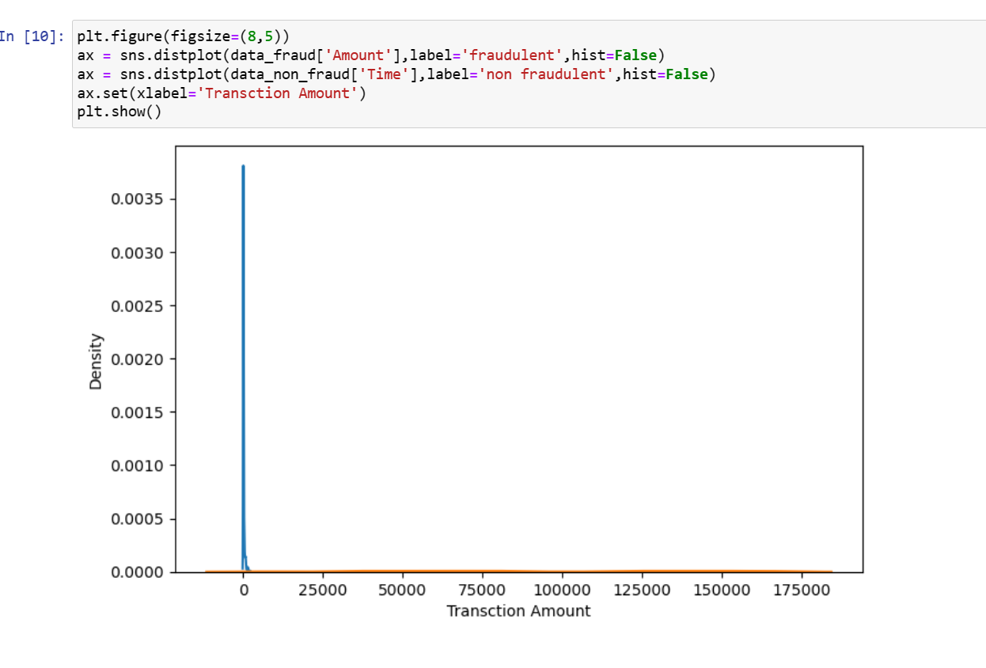
We are calculating the relationship of Fraudulent and Non- Fraudulent transaction with respect to Amount.
Insight
We do not see that the Fraud Transactions are mostly happened in the lower range of Amount, whereas the Non- Fraudulent transactions are spread through low to high range of Amount.

Slide 8
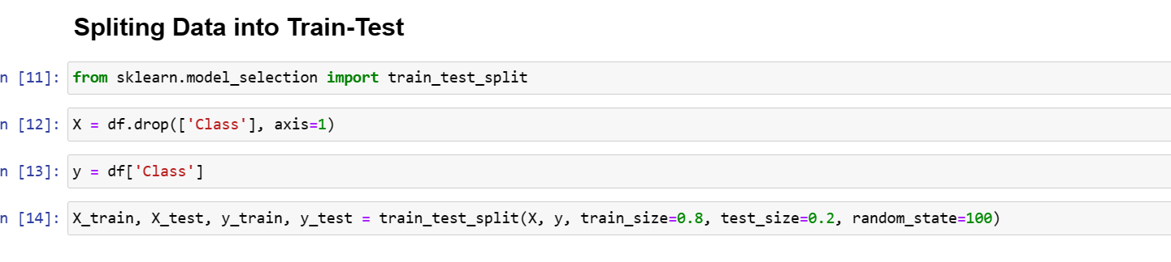
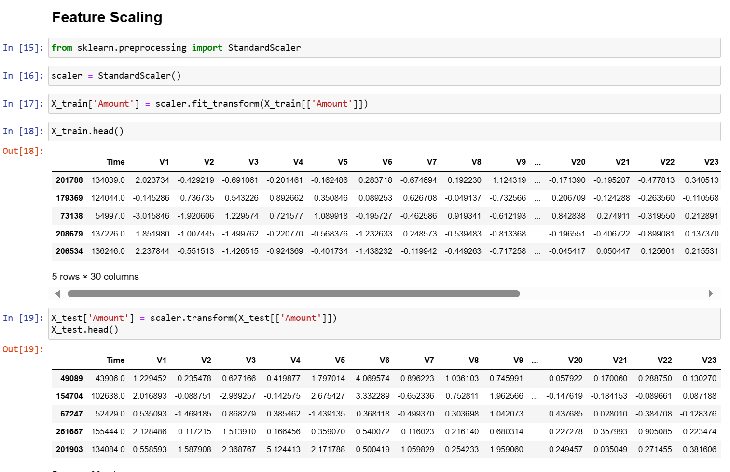
To make machine learn, we need to split the original data from training and testing part.
Here, we are taking Close column as dependent column where as all other features comes into the training part.
To put all features into the same range, regardless of their relevance, we need feature scaling. Feature Scaling Techniques. We bring all the features into the same range using feature scaling. There are many ways to do feature scaling like normalization, standardization, robust scaling, min-max scaling, etc.

Slide 9
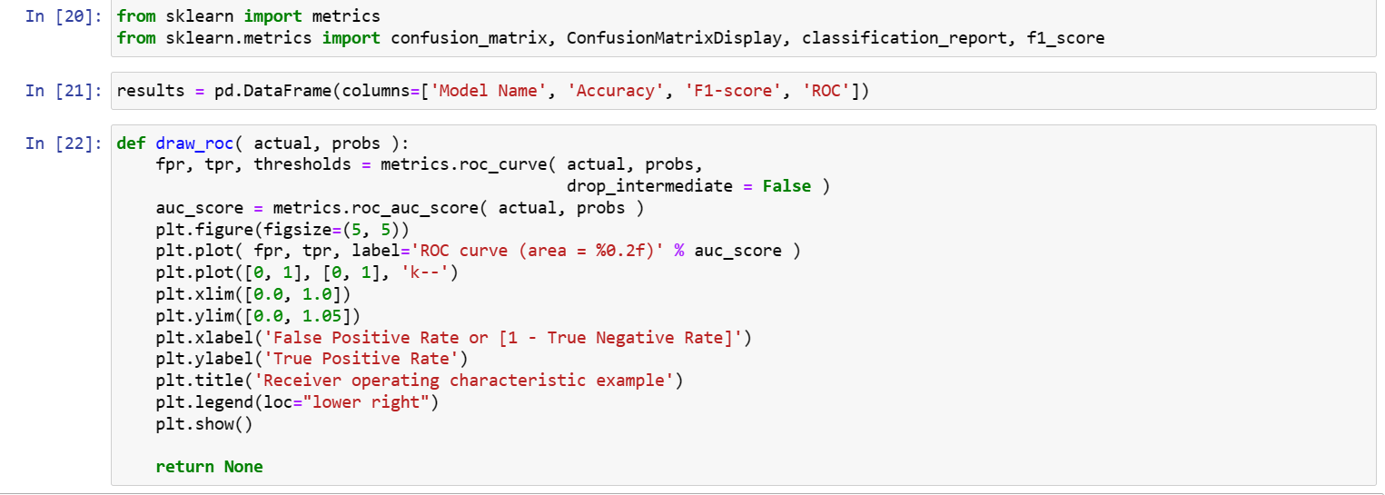
What are performance metrics?
In machine learning, model performance evaluation uses model monitoring to assess how well a model is performing at the specific task it was designed for. There are a variety of ways to carry out model evaluation in model monitoring, using metrics like classification

Slide 10
Logistic Regression

Slide 11
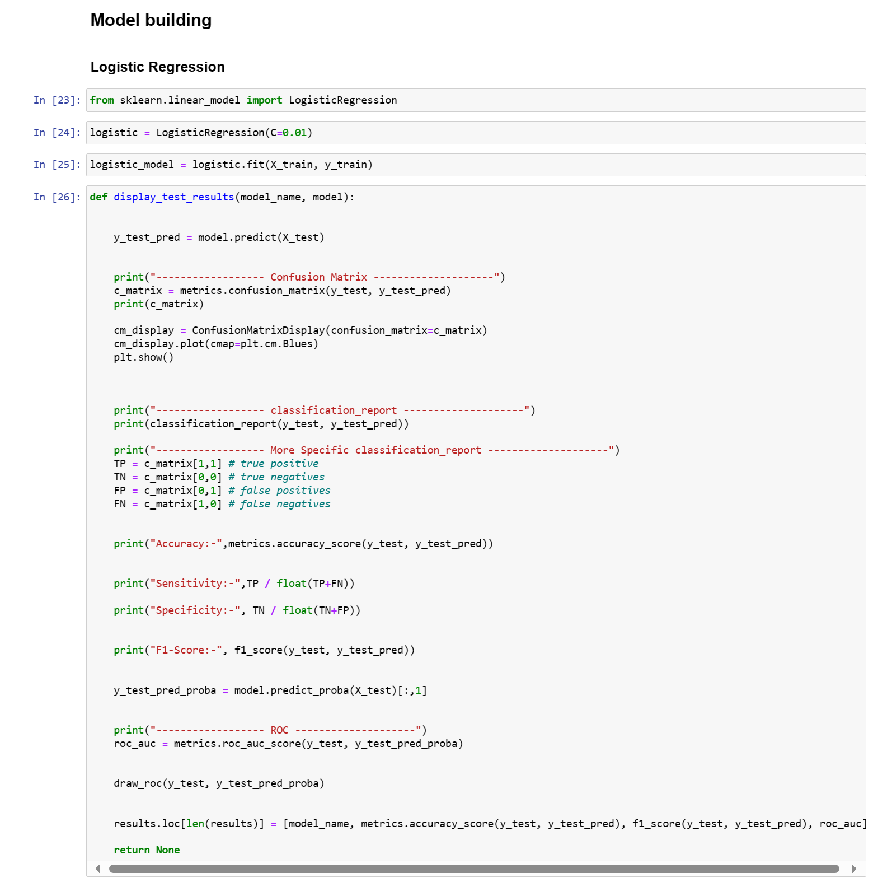
Within machine learning, logistic regression belongs to the family of supervised machine learning models. It is also considered a discriminative model, which means that it attempts to distinguish between classes (or categories)
likelihood function to determine the beta coefficients of the model. This changes slightly under the context of machine learning. Within machine learning, the negative log likelihood used as the loss function, using the process of gradient descent to find the global maximum. This is just another way to arrive at the same estimations discussed above.
Logistic regression can also be prone to overfitting, particularly when there is a high number of predictor variables within the model. Regularization is typically used to penalize parameters large coefficients when the model suffers from high dimensionality.

Slide 12
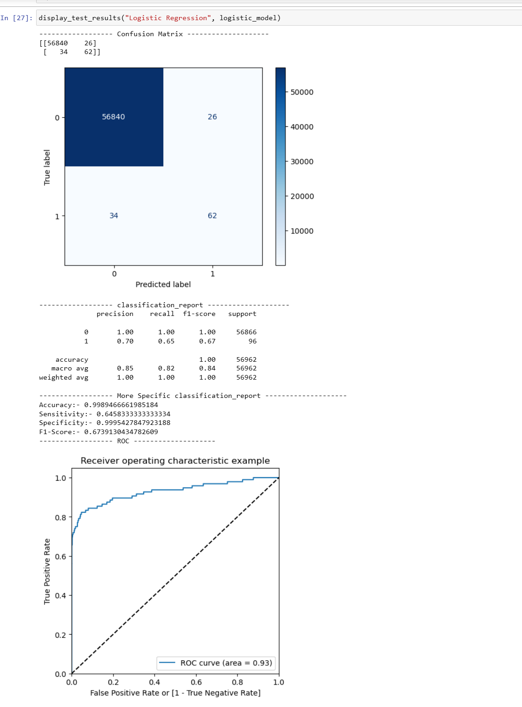

Slide 13
XGBOOST

Slide 14
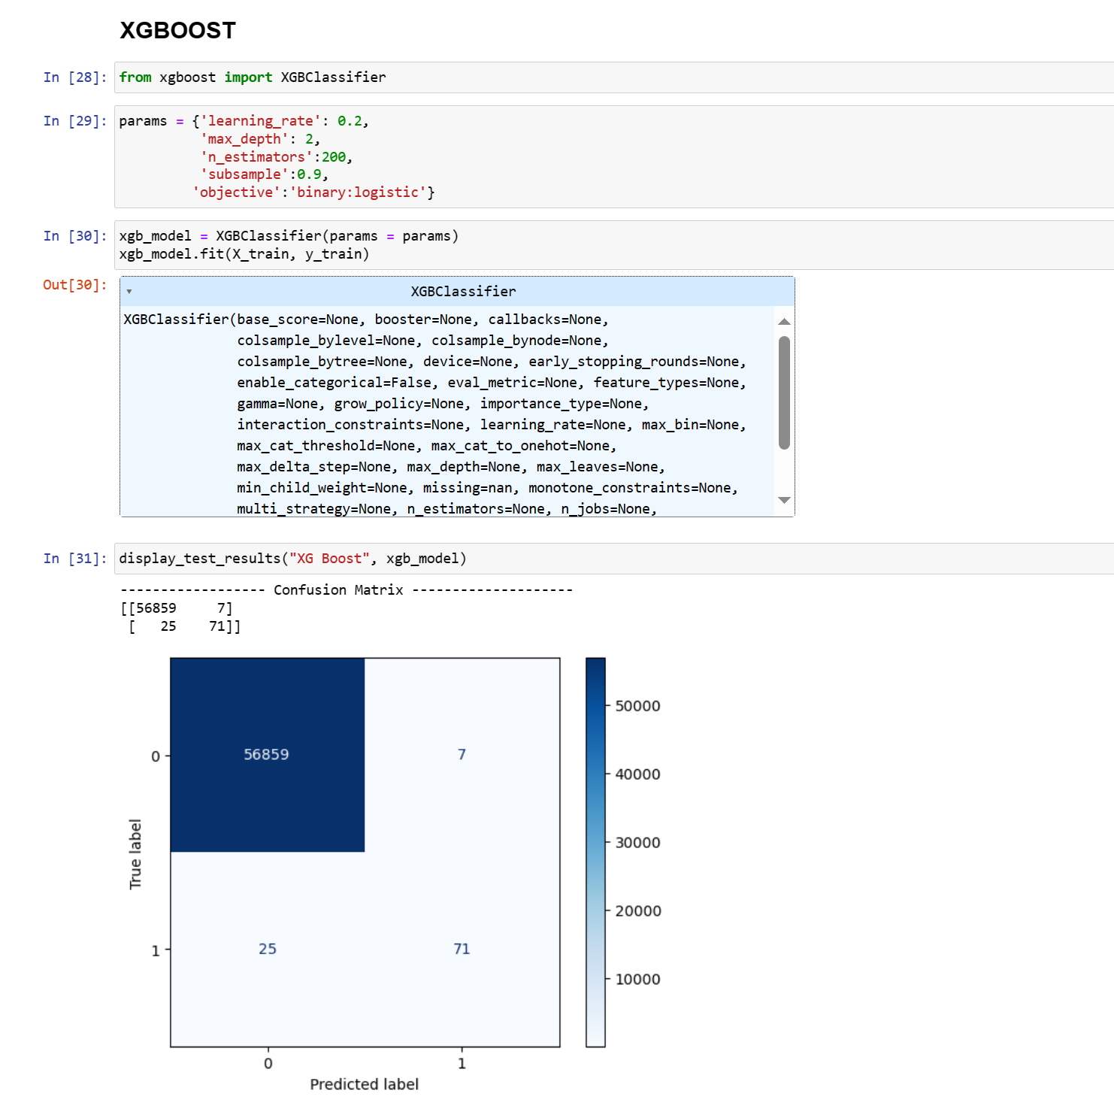
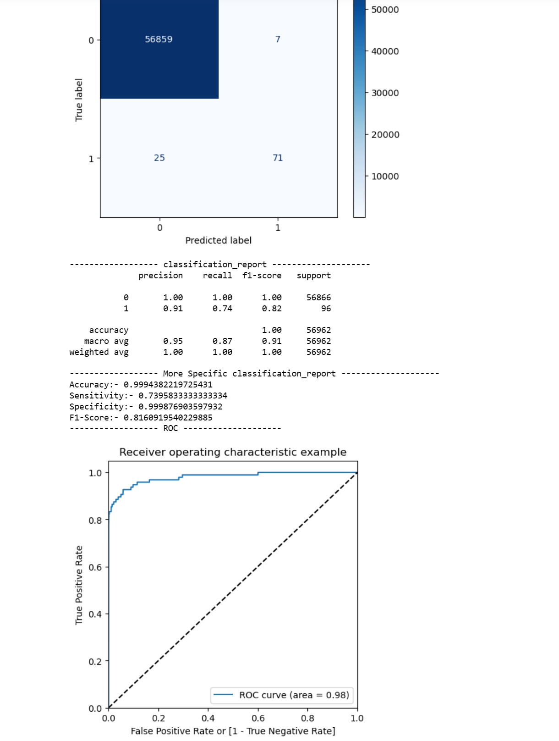
XGBoost is designed for speed, ease of use, and performance on large datasets. It does not require optimization of the parameters or tuning, which means that it can be used immediately after installation without any further configuration.
Fig(1)
XGBoost is a robust machine-learning algorithm that can help you understand your data and make better decisions.
XGBoost is an implementation of gradient-boosting decision trees. It has been used by data scientists and researchers worldwide to optimize their machine-learning models.
Fig(2)

Slide 15
Decision Tree

Slide 16
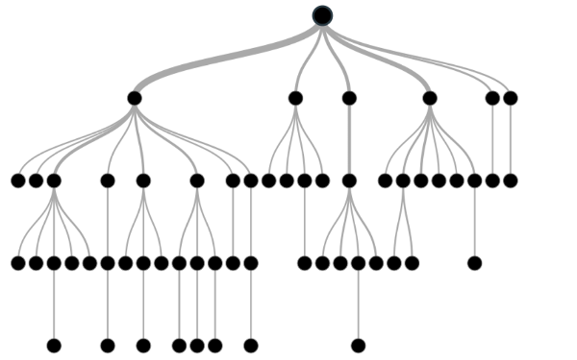
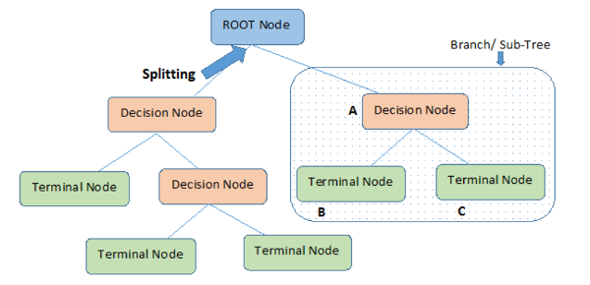
What is a Decision Tree?
A decision tree is a non-parametric supervised learning algorithm for classification and regression tasks. It has a hierarchical tree structure consisting of a root node,
branches, internal nodes, and leaf nodes. Decision trees are used for classification and regression tasks, providing easy-to-understand models.
A decision tree is a hierarchical model used in decision support that depicts decisions and their potential outcomes, incorporating chance events, resource expenses,
and utility. This algorithmic model utilizes conditional control statements and is non-parametric, supervised learning, useful for both classification and regression tasks.
The tree structure is comprised of a root node, branches, internal nodes, and leaf nodes, forming a hierarchical, tree-like structure.
It is a tool that has applications spanning several different areas. Decision trees can be used for classification as well as regression problems.
The name itself suggests that it uses a flowchart like a tree structure to show the predictions that result from a series of feature-based splits.
It starts with a root node and ends with a decision made by leaves.
Understanding A/B Testing Pitfalls in Business Decision Making
Root Node: The initial node at the beginning of a decision tree, where the entire population or dataset starts dividing based on various features or conditions.
Decision Nodes: Nodes resulting from the splitting of root nodes are known as decision nodes.
These nodes represent intermediate decisions or conditions within the tree.
Leaf Nodes: Nodes where further splitting is not possible, often indicating the final classification or outcome.
Leaf nodes are also referred to as terminal nodes.
Sub-Tree: Similar to a subsection of a graph being called a sub-graph, a sub-section of a decision tree is referred to as a sub-tree.
It represents a specific portion of the decision tree.
Pruning: The process of removing or cutting down specific nodes in a decision tree to prevent overfitting and simplify the model.
Branch / Sub-Tree: A subsection of the entire decision tree is referred to as a branch or sub-tree. It represents a specific path of decisions and outcomes within the tree.
Parent and Child Node: In a decision tree, a node that is divided into sub-nodes is known as a parent node,
and the sub-nodes emerging from it are referred to as child nodes. The parent node represents a decision or condition,
while the child nodes represent the potential outcomes or further decisions based on that condition.

Slide 17
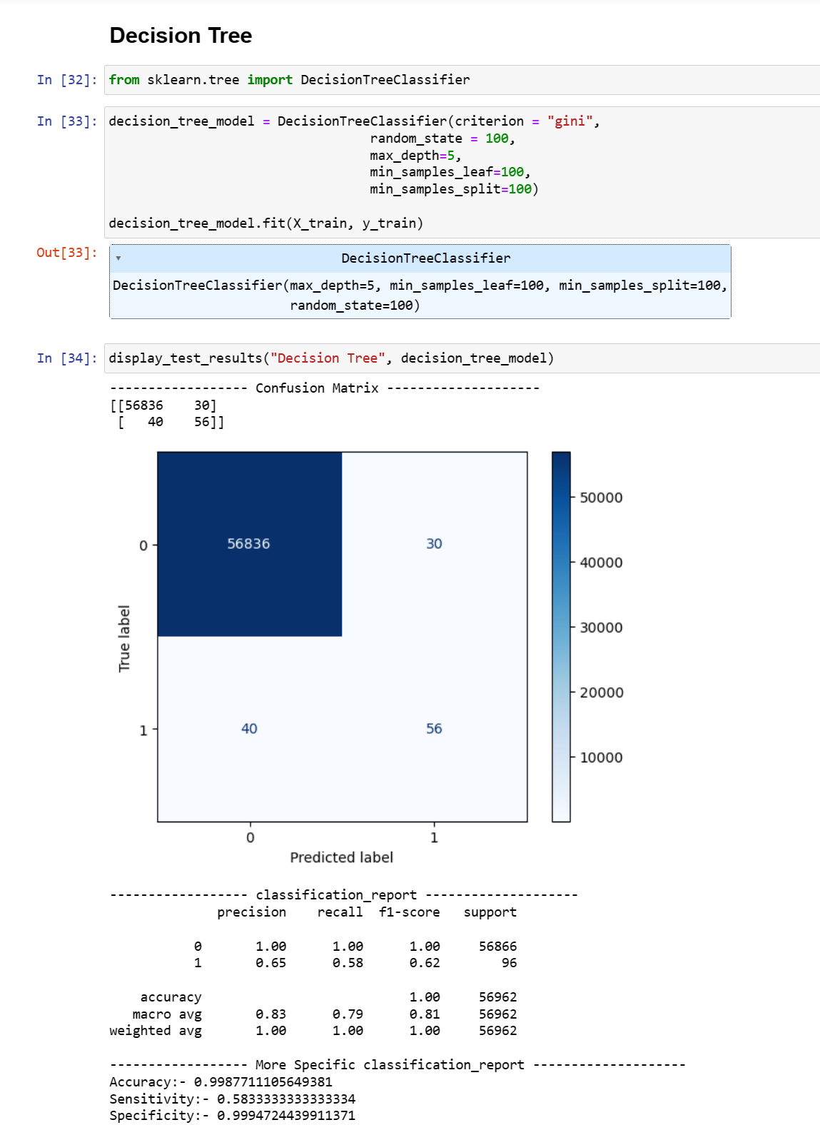
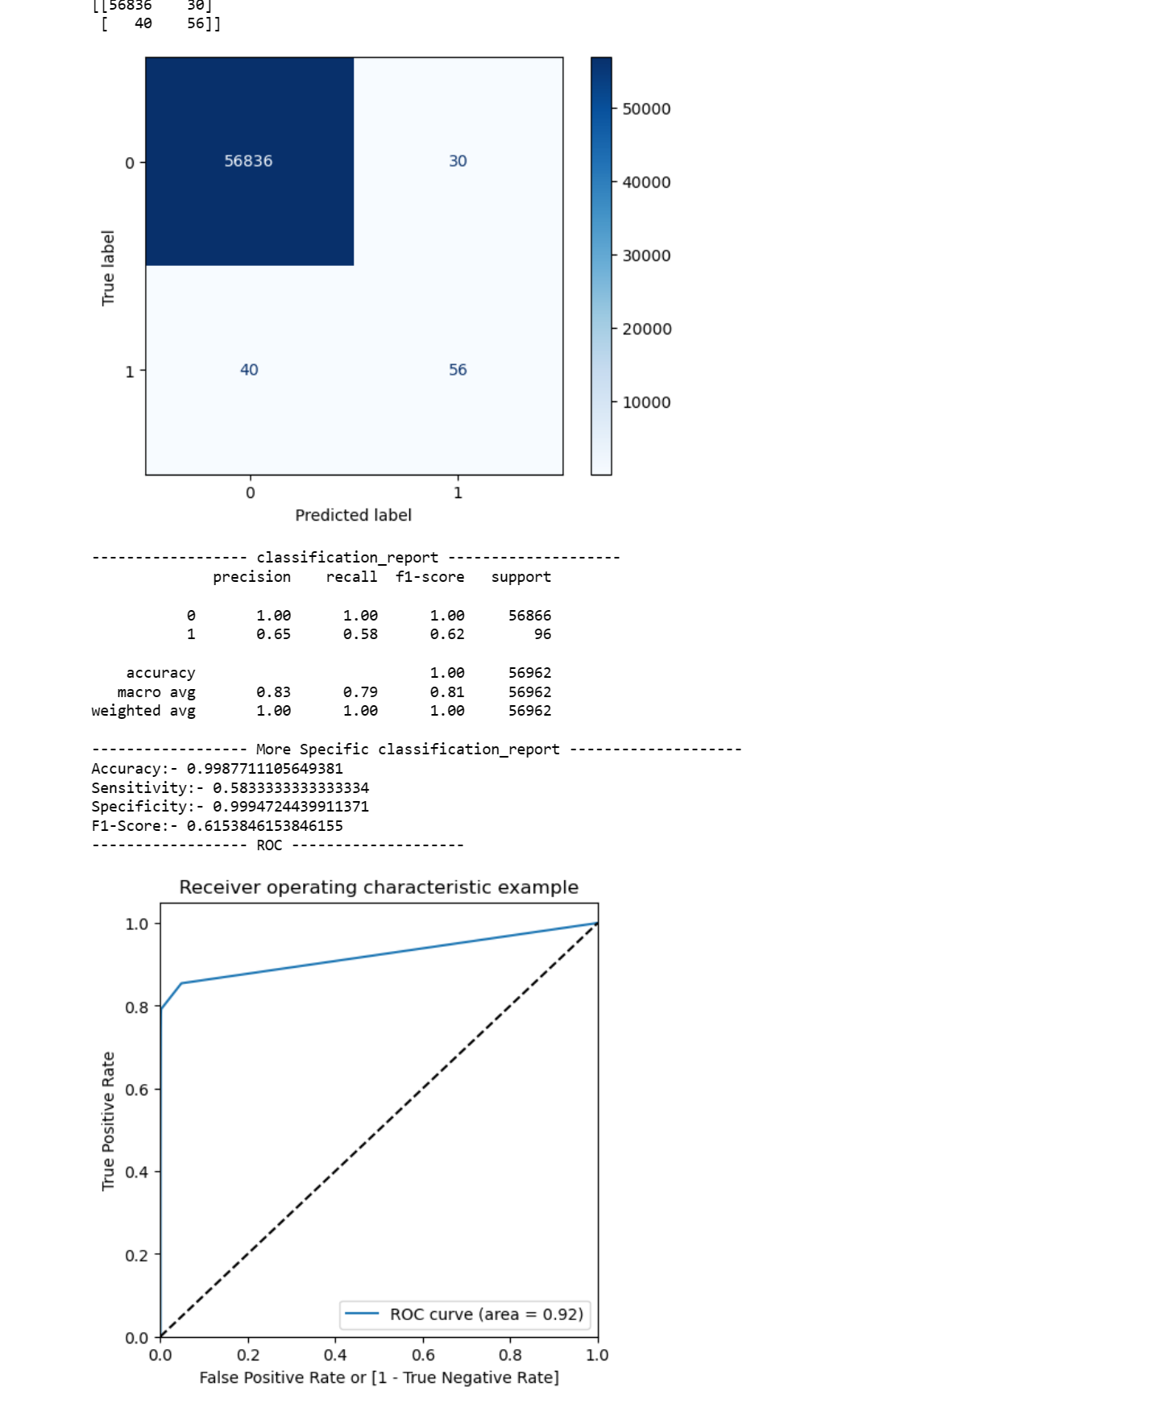
fig(1)
Fig(2)

Slide 18
Random Forest

Slide 19
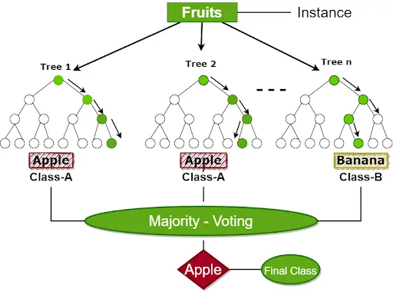
What is Random Forest Algorithm?
Random Forest is a famous machine learning algorithm that uses supervised learning methods. You can apply it to both classification and regression problems. It is based on ensemble learning, which integrates multiple classifiers to solve a complex issue and increases the model's performance.
In layman's terms, Random Forest is a classifier that contains several decision trees on various subsets of a given dataset and takes the average to enhance the predicted accuracy of that dataset. Instead of relying on a single decision tree, the random forest collects the result from each tree and expects the final output based on the majority votes of predictions.
Now that you know what Random Forest Classifier is and why it is one of the most used classification algorithms in machine learning, let's dive into a real-life analogy to understand it better.
Working of Random Forest Algorithm-:
The Working of the Random Forest Algorithm is quite intuitive. It is implemented in two phases: The first is to combine N decision trees with building the random forest, and the second is to make predictions for each tree created in the first phase.
The following steps can be used to demonstrate the working process:
Step 1: Pick M data points at random from the training set.
Step 2: Create decision trees for your chosen data points (Subsets).
Step 3: Each decision tree will produce a result. Analyze it.
Step 4: For classification and regression, accordingly, the final output is based on Majority Voting or Averaging, accordingly.
The flowchart below will help you understand better:

Slide 20
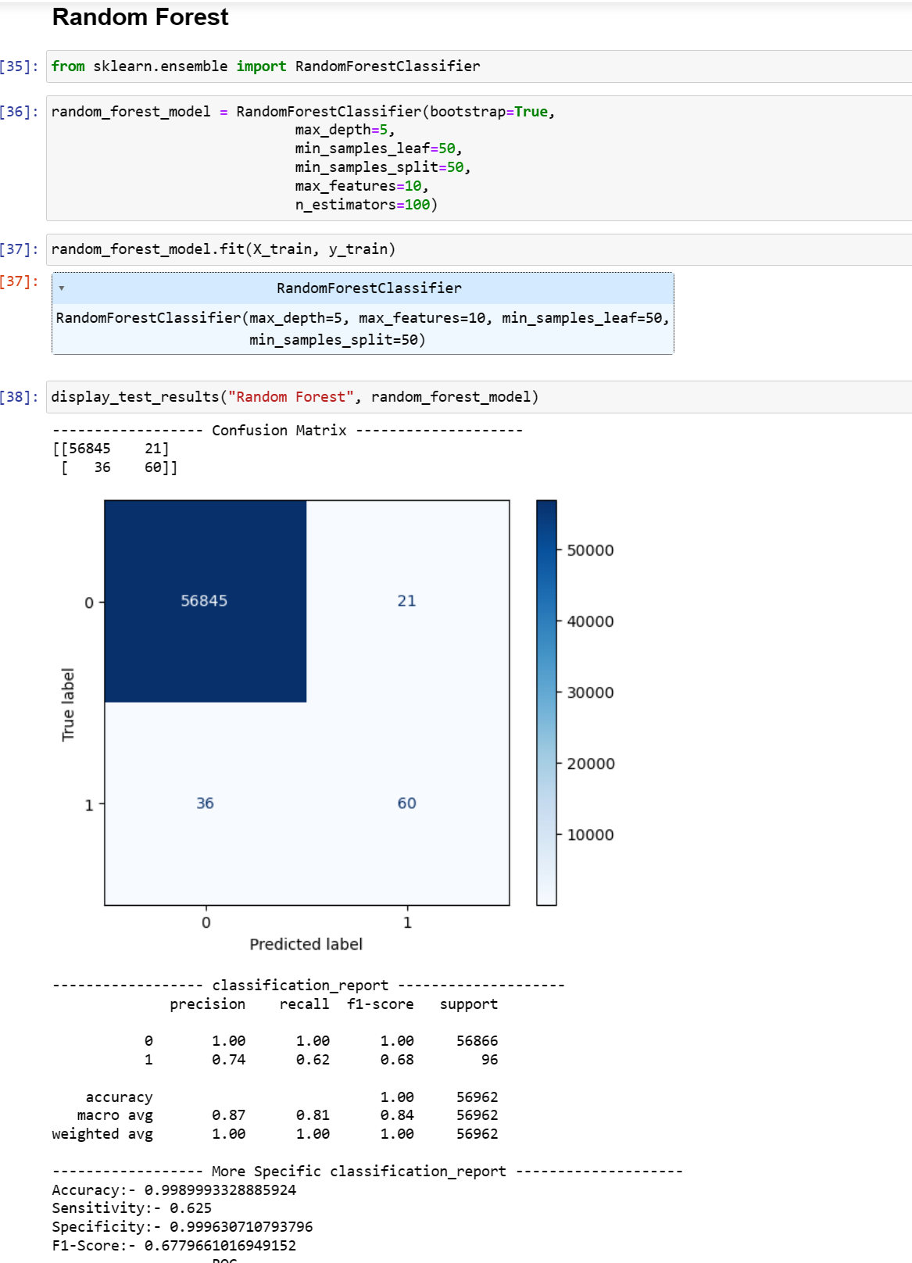
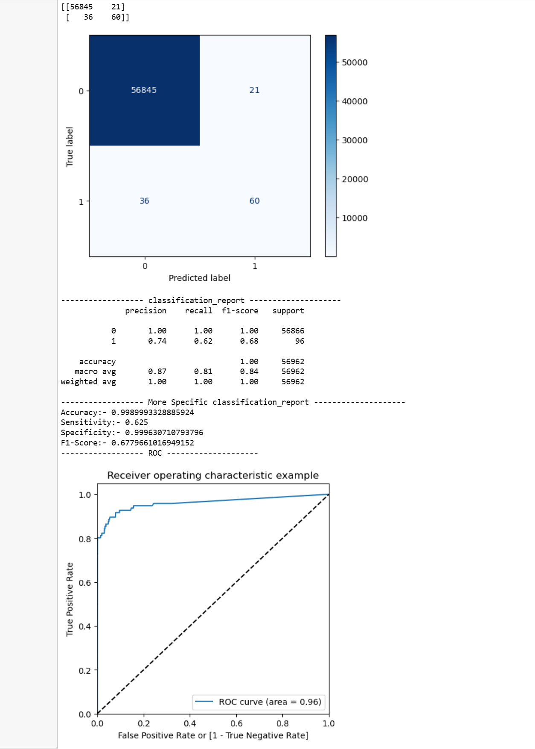
Fig(1)
Fig(2)

Slide 21
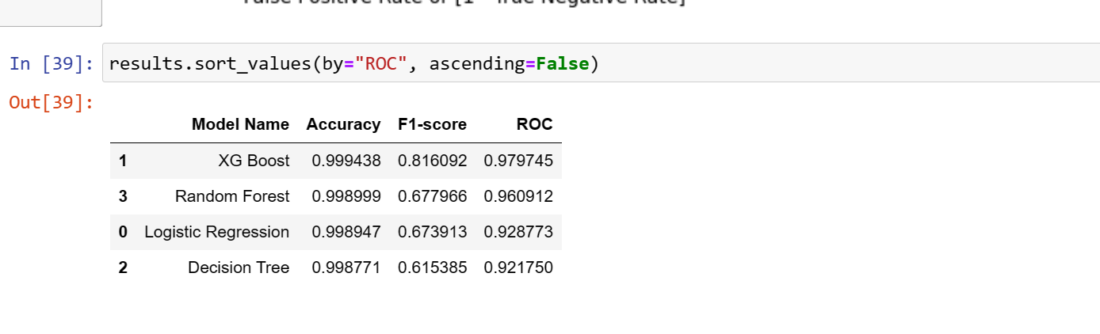
why we use multiple algorithms for one problem in machine learning?
Employing multiple algorithms in machine learning enhances performance, robustness, and interpretability. By comparing and evaluating different approaches, the most suitable solution for a given problem can be identified. Combining outputs from diverse algorithms into an ensemble mitigates bias and variance.
Conclusion -: After using Multiple Machine Learning Algorithm, calculating Performance Metrics, we can say ,XG Boost algorithm providing the much better result following by the random forest and then Logistic Regression.
Decision tree provides relatively less accurate result.
By using XG Boost Machine Learning Algorithm, we can get efficient Model for this credit-card fraudulent Transaction.

Slide 22
Thank You

